Slide 1
http://www.vidyanidhi.com/
ketkiacharya.net@gmail.com
Ketki Acharya
From: SM VITA ATC of CDAC
ketkiacharya.net@gmail.com

Slide 2
Public class Caculator : Icalculator
{
Void calculate( )
{
…..doing job
}
}
Public class Abacus : Icalculator
{
Void calculate( )
{
…..doing job
}
}
DI
Interface Icalculator
{
Void calculate();
}
Public calss Math
{ Icalculator cobj;
Public Math(Icalculator obref)
{
cobj=obref;
}
Public void dojob()
{
cobj.calculate();
}
}
new Abacus ()
abobj
new Math( abobj);
ob
Caculator calobj=new Caculator ();
Abacus abobj=new Abacus ();
Math ob=new Math( abobj);
Math ob=new Math(new Abacus ());
Math ob=new Math( abobj);
obref
Icalculator obref

Slide 3
MVC
ASP.NET MVC core is a web framework based on
Mode1-View-Controller (MVC) architecture.
Developers can build dynamic web applications using ASP.NET MVC core enables a clean separation of concerns,
fast development, and
TDD friendly.

Slide 4
Model represents the data
Model: Model represents the shape of the data. A class in C# is used to describe a model. Model objects store data retrieved from the database.
View is the User Interface..
View: View in MVC is a user interface. View display model data to the user and also enables them to modify them. View in ASP.NET MVC is HTML, CSS, and some special syntax (Razor syntax) that makes it easy to communicate with the model and the controller.
Controller: The controller handles the user request. Typically, the user uses the view and raises an HTTP request, which will be handled by the controller. The controller processes the request and returns the appropriate view as a response.
Program file is the request handler.
var builder = WebApplication.CreateBuilder(args);
// Add services to the container.
builder.Services.AddControllersWithViews();
builder.Services.AddSingleton<IEmployeeRepository, MockEmployeeRepository>();
var app = builder.Build();
// Configure the HTTP request pipeline.
if (!app.Environment.IsDevelopment())
{
app.UseExceptionHandler("/Home/Error");
// The default HSTS value is 30 days. You may want to change this for production scenarios, see https://aka.ms/aspnetcore-hsts.
app.UseHsts();
}

Slide 5
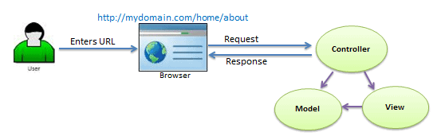
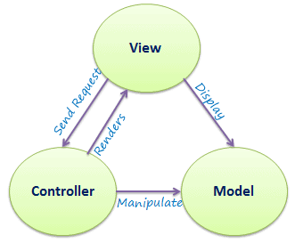
As per the above figure, when a user enters a URL in the browser, it goes to the webserver and routed to a controller.
A controller executes related view and models for that request and create the response and sends it back to the browser.

Slide 6
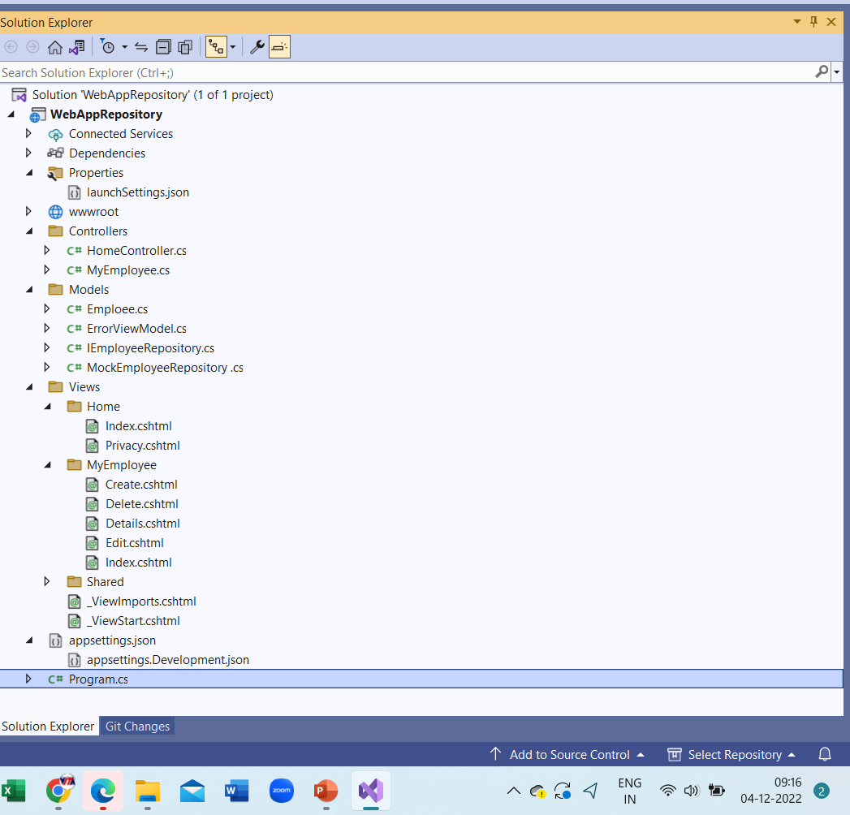
ASP.NET MVC Folder Structure
Controllers
The Controllers folder contains class files for the controllers. A Controller handles users' request and returns a response. MVC requires the name of all controller files to end with "Controller".

Slide 7
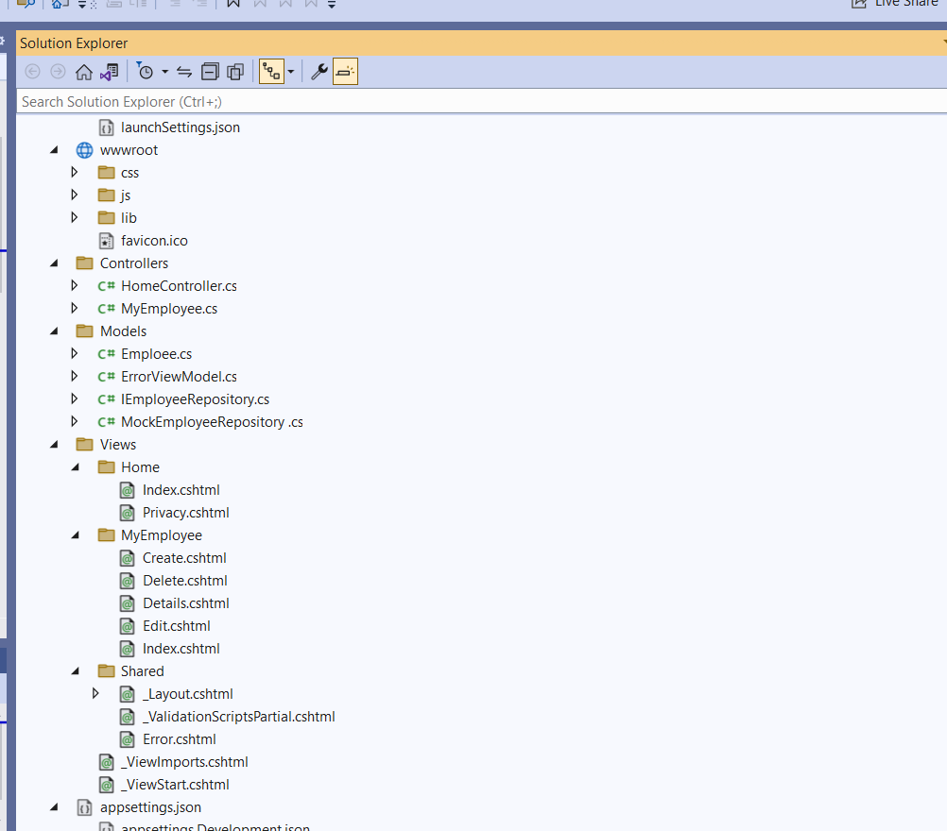
ASP.NET MVC Folder Structure
Views
The Views folder contains HTML files for the application. Typically view file is a .cshtml file where you write HTML and C# or VB.NET code.
The Views folder includes a separate folder for each controller. For example, all the .cshtml files, which will be rendered by HomeController will be in View > Home folder.
The Shared folder under the View folder contains all the views shared among different controllers e.g., layout files.
Models
The Models folder contains model class files. Typically model class includes public properties, which will be used by the application to hold and manipulate application data.

Slide 8
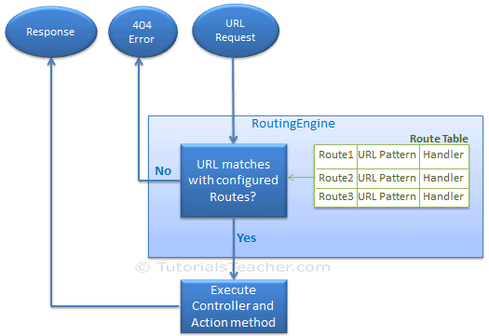
Routing in MVC
In the php application, every URL must match with a specific .php file. For example, a URL http://domain/studentsinfo.php must match with the file studentsinfo.php that contains code and markup for rendering a response to the browser.
Route defines the URL pattern and handler information. All the configured routes of an application stored in Endpoint class determine appropriate handler class or file for an incoming request

Slide 9
Configure a Route
Every MVC application must configure (register) at least one route configured by the MVC framework by default.
As you can see in the above figure, the route is configured using the MapControllerRoute extension method of IEndpointRouteBuilder where name is "Default", url pattern is "{controller}/{action}/{id}" and defaults parameter for controller, action method and id parameter.
Defaults specify which controller, action method, or value of id parameter should be used if they do not exist in the incoming request URL.
//
// Summary:
// Builds the Microsoft.AspNetCore.Builder.WebApplication.
//
// Returns:
// A configured Microsoft.AspNetCore.Builder.WebApplication.
public WebApplication Build();
app.MapControllerRoute(
name: "default",
pattern: "{controller=Home}/{action=Index}/{id?}");
Adds endpoints for controller actions to the Microsoft.AspNetCore.Routing.IEndpointRouteBuilder
// and specifies a route with the given name, pattern, defaults, constraints, and
// dataTokens.

Slide 10
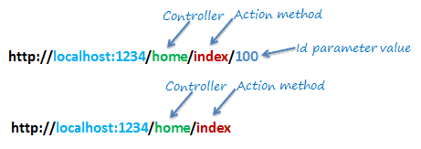
URL Pattern
The URL pattern is considered only after the domain name part in the URL. For example, the URL pattern "{controller}/{action}/{id}" would look like localhost:1234/{controller}/{action}/{id}. Anything after "localhost:1234/" would be considered as a controller name. The same way, anything after the controller name would be considered as action name and then the value of id parameter.
If the URL doesn't contain anything after the domain name, then the default controller and action method will handle the request. For example, http://localhost:1234 would be handled by the HomeController and the Index() method as configured in the default parameter.

Slide 11
The following table shows which Controller, Action method, and Id parameter would handle different URLs considering the above default route.
URL | Controller | Action | Id
http://localhost/home | HomeController | Index | null
http://localhost/home/index/123 | HomeController | Index | 123
http://localhost/home/about | HomeController | About | null
http://localhost/home/contact | HomeController | Contact | null
http://localhost/student | StudentController | Index | null
http://localhost/student/edit/123 | StudentController | Edit | 123

Slide 12
Multiple Routes
You can also configure a custom route using the MapRoute extension method. You need to provide at least two parameters in MapRoute, route name, and URL pattern. The Defaults parameter is optional.
You can register multiple custom routes with different names. Consider the following example where we register "Student" route.
As shown in the above code, the URL pattern for the Student route is students/{id}, which specifies that any URL that starts with domainName/students, must be handled by the StudentController.
Notice that we haven't specified {action} in the URL pattern because we want every URL that starts with students should always use the Index() action of the StudentController class. We have specified the default controller and action to handle any URL request, which starts from domainname/students.
MVC framework evaluates each route in sequence.
It starts with the first configured route, and if incoming URL doesn't satisfy the URL pattern of the route, then it will evaluate the second route and so on. In the above example, routing engine will evaluate the Student route first and if incoming URL doesn't start with /students then only it will consider the second route which is the default route.
app.IgnoreRoute("{resource}.axd/{*pathInfo}");
app. MapControllerRoute(( name: "Student",
url: "students/{id}",
defaults: new { controller = "Student", action = "Index"}
);
app. MapControllerRoute(( name: "Default",
url: "{controller}/{action}/{id}",
defaults: new { controller = "Home", action = "Index", id = UrlParameter.Optional }
);
}
URL | Controller | Action | Id
http://localhost/student/123 | StudentController | Index | 123
http://localhost/student/index/123 | StudentController | Index | 123
http://localhost/student?Id=123 | StudentController | Index | 123

Slide 13
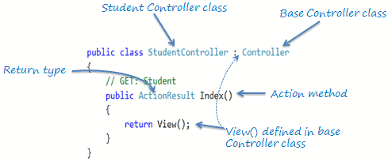
Controller/ Action method
The Controller in MVC architecture handles any incoming URL request. The Controller is a class, derived from the base class System.Web.Mvc.Controller. Controller class contains public methods called Action methods. Controller and its action method handles incoming browser requests, retrieves necessary model data and returns appropriate responses.
In ASP.NET MVC, every controller class name must end with a word "Controller". For example, the home page controller name must be HomeController, and for the student page, it must be the StudentController. Also, every controller class must be located in the Controller folder of the MVC folder structure.
All the public methods of the Controller class are called Action methods.
As you can see in the above figure, the Index() method is public, and it returns the ActionResult using the View() method. The View() method is defined in the Controller base class, which returns the appropriate ActionResult.

Slide 14
Default Action Method
Every controller can have a default action method as per the configured route in the RouteConfig class. By default, the Index() method is a default action method for any controller, as per configured default root, as shown below.
app.MapRoute( name: "Default",
url: "{controller}/{action}/{id}/{name}",
defaults: new { controller = "Home", action = "Index", id = UrlParameter.Optional });
However, you can change the default action name as per your requirement in the RouteConfig class.

Slide 15
ActionResult
MVC framework includes various Result classes, which can be returned from an action method. The result classes represent different types of responses, such as HTML, file, string, JSON, javascript, etc. The following table lists all the result classes available in ASP.NET MVC.
The ActionResult class is a base class of all the above result classes, so it can be the return type of action method that returns any result listed above. However, you can specify the appropriate result class as a return type of action method.
Result Class | Description
ViewResult | Represents HTML and markup.
EmptyResult | Represents No response.
ContentResult | Represents string literal.
FileContentResult/ FilePathResult/ FileStreamResult | Represents the content of a file.
JavaScriptResult | Represent a JavaScript script.
JsonResult | Represent JSON that can be used in AJAX.
RedirectResult | Represents a redirection to a new URL.
RedirectToRouteResult | Represent another action of same or other controller.
PartialViewResult | Returns HTML from Partial view.
HttpUnauthorizedResult | Returns HTTP 403 status.

Slide 16
ViewResult
The Index() method of the StudentController in the above figure uses the View() method to return a ViewResult (which is derived from the ActionResult class).
The base Controller class includes the View() method along with other methods that return a particular type of result, as shown in the below table.
Result Class | Description | Base Controller Method
ViewResult | Represents HTML and markup. | View()
EmptyResult | Represents No response.
ContentResult | Represents string literal. | Content()
FileContentResult, FilePathResult, FileStreamResult | Represents the content of a file. | File()
JavaScriptResult | Represents a JavaScript script. | JavaScript()
JsonResult | Represents JSON that can be used in AJAX. | Json()
RedirectResult | Represents a redirection to a new URL. | Redirect()
RedirectToRouteResult | Represents redirection to another route. | RedirectToRoute()
PartialViewResult | Represents the partial view result. | PartialView()
HttpUnauthorizedResult | Represents HTTP 403 response.

Slide 17
Action Method Parameters
[HttpPost]
public ActionResult Edit(Student std)
{ // update student to the database
return RedirectToAction("Index");
}
[HttpDelete]
public ActionResult Delete(int id)
{ // delete student from the database whose id matches with specified id
return RedirectToAction("Index");
}
By default, the values for action method parameters are retrieved from the request's data collection. The data collection includes name/values pairs for form data or query string values or cookie values. Model binding in ASP.NET MVC automatically maps the URL query string or form data collection to the action method parameters if both names match.

Slide 18
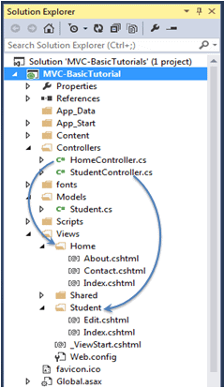
Create a View in ASP.NET MVC
A view is used to display data using the model class object. The Views folder contains all the view files in the ASP.NET MVC application.
A controller can have one or more action methods, and each action method can return a different view. In short, a controller can render one or more views. So, for easy maintenance, the MVC framework requires a separate sub-folder for each controller with the same name as a controller, under the Views folder.
For example, all the views rendered from the HomeController will resides in the Views > Home folder. In the same way, views for StudentController will resides in Views > Student folder, as shown below.
Note:
The Shared folder contains views, layout views, and partial views, which will be shared among multiple controllers
Note:
Every view in the ASP.NET MVC is derived from WebViewPage class included in System.Web.Mvc namespace.
Razor View Engine
Microsoft introduced the razor view engine to compile a view with a mix of HTML tags and server-side code. The special syntax for razor view maximizes the speed of writing code by minimizing the number of characters and keystrokes required when writing a view.
The razor view uses @ character to include the server-side code instead of the traditional <% %> of ASP. You can use C# or Visual Basic syntax to write server-side code inside the razor view.
ASP.NET MVC supports the following types of razor view files:
File extension | Description
.cshtml | C# Razor view. Supports C# code with html tags.

Slide 19
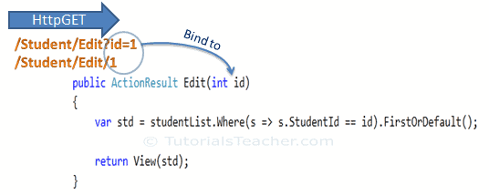
Bind Query String to an Action Method Parameters in MVC
Binding to Primitive Type
The HTTP GET request embeds data into a query string. MVC framework automatically converts a query string to the action method parameters provided their names are matching. For example, the query string id in the following GET request would automatically be mapped to the Edit() action method's id parameter.
Model Binding
This binding is case insensitive. So "id" parameter can be "ID" or "Id".
You can also have multiple parameters in the action method with different data types. Query string values will be converted into parameters based on the matching names.
For example, the query string parameters of an HTTP request http://localhost/Student/Edit?id=1&name=John would map to id and name parameters of the following Edit() action method.
For example, the query string parameters of an HTTP request http://localhost/Student/Edit?id=1&name=John would map to id and name parameters of the following Edit() action method.
public ActionResult Edit(int id, string name)
{
// do something here
return View();
}
This binding is case insensitive. So "id" parameter can be "ID" or "Id".

Slide 20
Binding to Complex Type
Model binding also works on complex types. It will automatically convert the input fields data on the view to the properties of a complex type parameter of an action method in HttpPost request if the properties' names match with the fields on the view.
[HttpPost]
public ActionResult Edit(Student std)
{
var id = std.StudentId;
var name = std.StudentName;
var age = std.Age;
var standardName = std.standard.StandardName;
//update database here..
return RedirectToAction("Index");
}
public class Student
{
public int StudentId { get; set; }
public string StudentName { get; set; }
public int Age { get; set; }
public Standard standard { get; set; }
}
public class Standard
{
public int StandardId { get; set; }
public string StandardName { get; set; }
}
Now, you can create an action method which includes the Student type parameter. In the following example, Edit action method (HttpPost) includes Student type parameter.

Slide 21
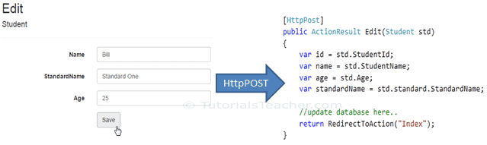
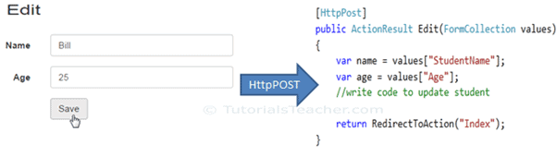
Thus, the MVC framework will automatically map Form collection values to the Student type parameter when the form submits an HTTP POST request to the Edit() action method, as shown below.
So thus, it automatically binds form fields to the complex type parameter of action method
FormCollection
You can also include the FormCollection type parameter in the action method instead of a complex type to retrieve all the values from view form fields, as shown below.

Slide 22
MetadataTypeAttribute
[MetadataType(typeof(EmployeeMetaData))]
public partial class Employee
{
}
public class EmployeeMetaData
{
[Required]
public string Name { get; set; }
[Required]
public string Gender { get; set; }
[Required]
public string City { get; set; }
[Required]
[Display(Name = "Department")]
public int DepartmentId { get; set; }
}
The MetadataTypeAttribute attribute enables you to associate a class with a data-model partial class. In this associated class you provide additional metadata information that is not in the data model.

Slide 23
All Validation
[HiddenInput(DisplayValue = false)]
public int Id { get; set; }
[Required(ErrorMessage = "Please enter your name")]
public string Name { get; set; }
[Required(ErrorMessage = "Please enter your email address")]
[RegularExpression(".+\\@.+\\..+",
ErrorMessage = "Please enter a valid email address")]
public string Email { get; set; }
[RegularExpression("[0-9]{10}",
ErrorMessage = "Please enter a valid mobile address")]
[Required(ErrorMessage = "Please enter your phone number")]
public string Phone { get; set; }
[DataType(DataType.Url)]
public string PersonalWebSite { get; set; }
[DataType(DataType.Currency)]
public int? Salary { get; set; }
[Display(Name = "Hire Date")]
[DisplayFormat(DataFormatString = "{0:dd/MM/yyyy hh:mm:ss tt}")]
[DataType(DataType.DateTime)]
public DateTime? HireDate { get; set; }
//To get time in 12 hour notation with AM PM
[Display(Name = "Hire Date")]
[DisplayFormat(DataFormatString = "{0:dd/MM/yyyy hh:mm:ss tt}")]
[DataType(DataType.DateTime)]
public DateTime? HireDate { get; set; }
[StringLength(10, MinimumLength = 5)]
[Required]
[Display(Name = "Department Name")]
public string FullName { get; set; }
[Required]
[Range(1, 100)]
public int Age { get; set; }
[Required]
[DisplayFormat(DataFormatString = "{0:d}", ApplyFormatInEditMode = true)]
public System.DateTime HireDate { get; set; }
[Required]
[RegularExpression(@"^[\w-\._\+%]+@(?:[\w-]+\.)+[\w]{2,6}$", ErrorMessage = "Please enter a valid email address")]
public string EmailAddress { get; set; }
[Compare("EmailAddress")]
public string ConfirmEmail { get; set; }
using System.ComponentModel;
[DisplayName("Emp ID")]
public int Id { get; set; }

Slide 24
Demo All Validation
public class CustomerMetadata
{
[Key]
public int Id { get; set; }
[Required]
[DisplayName("Customer Name")]
public string Name { get; set; }
[Required]
public string Photo { get; set; }
[StringLength(15, MinimumLength = 8)]
[Required]
[DataType(DataType.Password)] //input type="Password"
public string Password { get; set; }
[Required]
[DataType(DataType.MultilineText)] //Textarea
public string Address { get; set; }
[Required]
[DataType(DataType.Date)] //input type="Date [Calander]
[DisplayFormat(DataFormatString = "{0:d}", ApplyFormatInEditMode = true)]
public System.DateTime DOB { get; set; }
[Required(ErrorMessage = "Please enter your URL correctly")]
[DataType(DataType.Url)] input type=url➔"Http...."
public string URL { get; set; }
[Required]
[DataType(DataType.EmailAddress)] //input type ="Email"
[RegularExpression(@"^[\w-\._\+%]+@(?:[\w-]+\.)+[\w]{2,6}$", ErrorMessage = "Please enter a valid email address")]
public string Email { get; set; }
[Compare("Email" ,ErrorMessage="Email and confirm Email should match")]
public string ConfirmEmail { get; set; }
[RegularExpression("[0-9]{10}", ErrorMessage = "Please enter a valid mobile address")]
[Required(ErrorMessage = "Please enter your phone number")]
[DataType(DataType.PhoneNumber)] //type="tel"
public string Mobile { get; set; }
public string Gender { get; set; }
public bool Remember { get; set; } //bool datatype give single checkbox
[RegularExpression("[0-9]{6}", ErrorMessage = "Please enter a valid Postal Code")]
[Required(ErrorMessage = "Please enter your Pin code")]
public string PostalCode { get; set; }
}
Create class Customer
With
Id
Name ➔min 3 max 15 character
Password ➔ Min 8 max 15
Address➔Text area
DOB➔ Calander
Age ➔range 18 to 105
Photo ➔image should be visible
URL
Email
ConfirmEmail [should be same as email=Compare]
Mobile
Gender
Remenber ➔ bool
Postal code
Gender ➔ drop down

Slide 25
ASP.NET Core Built-in Model Validation Attributes
Attribute | Purpose
Required | Specifies the field is required
Range | Specifies the minimum and maximum value allowed
MinLength | Specifies the minimum length of a string
MaxLength | Specifies the maximum length of a string
Compare | Compares 2 properties of a model. For example compare Email and ConfirmEmail properties
RegularExpression | Validates if the provided value matches the pattern specified by the regular expression
Images/a.png
C:\user\➔Physical Path
http://www.Localhost:445/images/a.png ➔Virtual Path

Slide 26
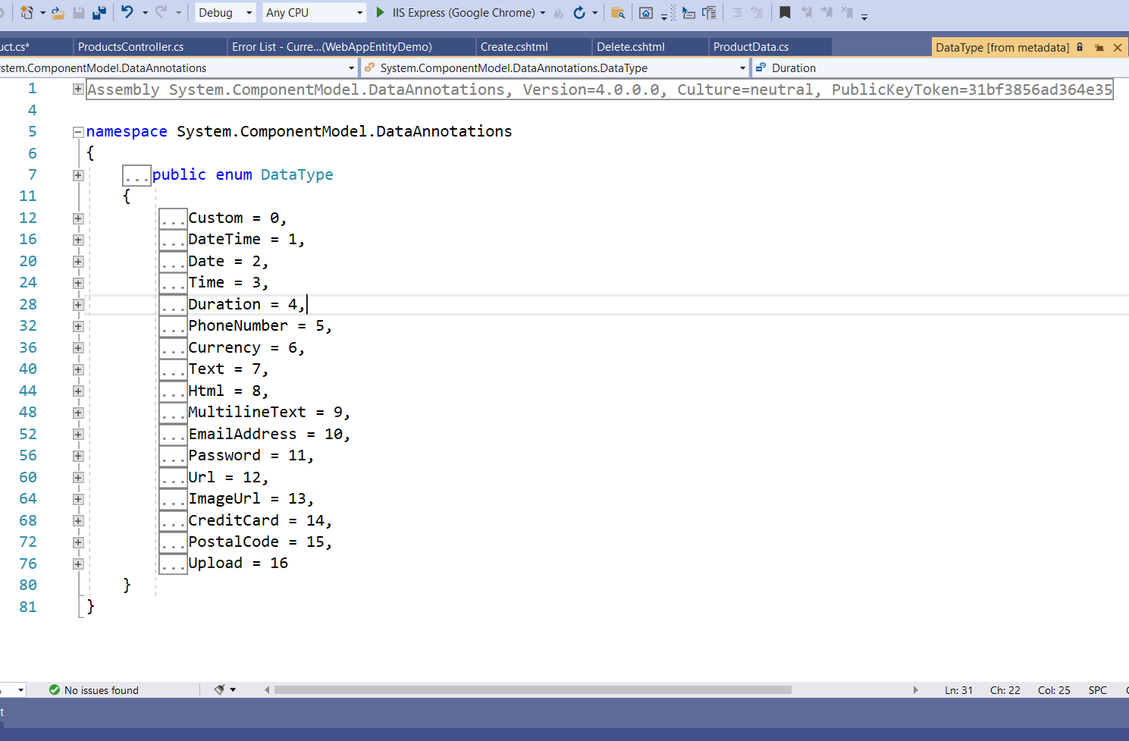

Slide 27
Drop Down
<div class="form-group">
<select asp-for="Department"
asp-items="Html.GetEnumSelectList<Dept>()">
</select>
<label asp-for="Department" class="control-label"></label>
<input asp-for="Department" class="form-control" />
<span asp-validation-for="Department" class="text-danger"></span>
</div>
public class Employee
{ public int Id { get; set; }
[Required, MaxLength(50, ErrorMessage = "Name cannot exceed 50 characters")]
public string? Name { get; set; }
[Display(Name = "Office Email")]
[RegularExpression(@"^[a-zA-Z0-9_.+-]+@[a-zA-Z0-9-]+\.[a-zA-Z0-9-.]+$",
ErrorMessage = "Invalid email format")]
[Required]
public string? Email { get; set; }
[Required]
public Dept? Department { get; set; }
}
public enum Dept
{
HR,
Payroll,
IT
}
To Display Image

Slide 29
That's it. Build the application and click on the link. Notice that, the page, now opens in a new window. The downside of this approach is that, from now on all the links, will open in a new window. To overcome this, follow these steps.
Rename Url.cshtml to OpenInNewWindow.cshtml
2. Decorate "PersonalWebSite" property in EmployeeMetaData class with UIHint attribute and specify the name of the template to use. In our case, the name of the template is "OpenInNewWindow".
public class EmployeeMetaData
{
[DataType(DataType.Url)]
[UIHint("OpenInNewWindow")]
public string PersonalWebSite { get; set; }
}
So, UIHint attribute is used to specify the name of the template to use to display the data field.

Slide 30
asp-append-version
When asp-append-version is specified with a true value along with a src attribute, the Image Tag Helper is invoked.
The following example uses an Image Tag Helper:
CSHTML
Copy
<img src="~/images/asplogo.png" asp-append-version="true">

